Slide 1
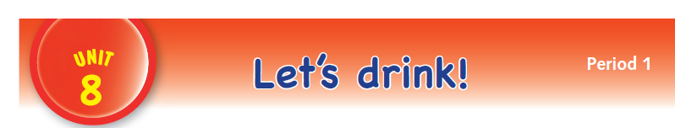

Slide 2
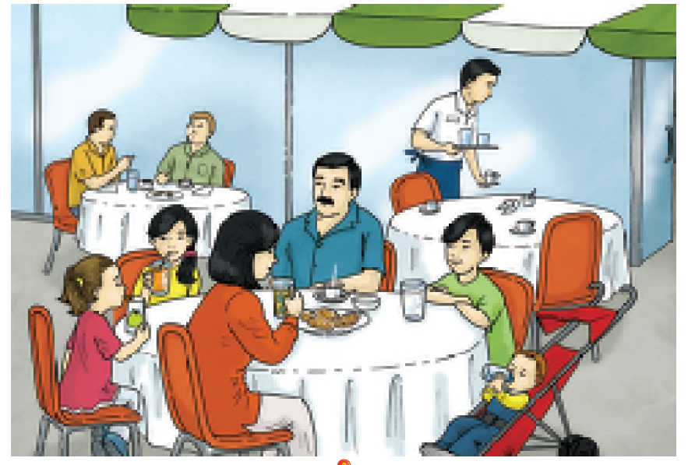

Slide 3
LANGUAGE PRESENTATION
water, milk, tea, coffee, apple juice, orange juice

Slide 4
PHONEMIC AWARENESS
The name is i. The sound is i. The name is q. The sound is q.
The name is g. The sound is g.

Slide 5

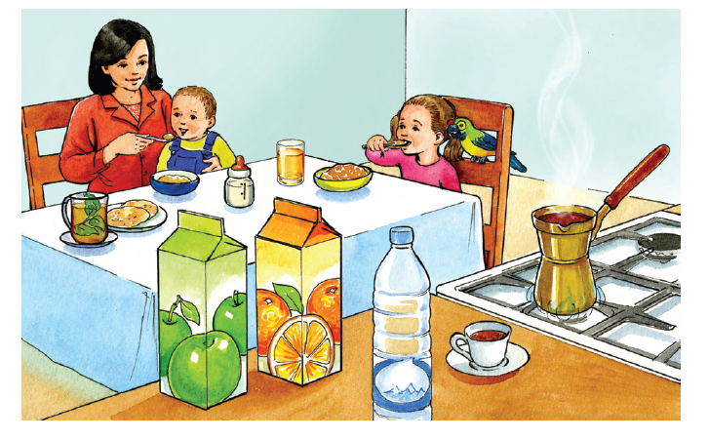
milk, coffee, orange juice, tea, apple juice, water

Slide 6

milk, coffee, orange juice, tea, apple juice, water

Slide 7

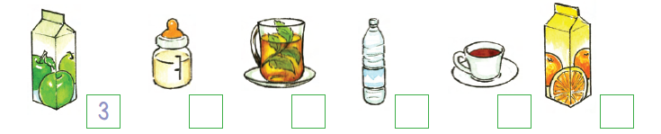
apple juice – three water – six
milk – four coffee – ten
tea – one orange juice – seven

Slide 8
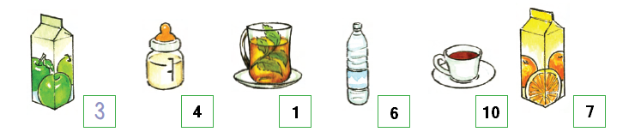
apple juice – three water – six
milk – four coffee – ten
tea – one orange juice – seven

Slide 9


coffee

Slide 10


milk

Slide 11


tea

Slide 12


apple juice

Slide 13


orange juice

Slide 14


water

