Slide 1
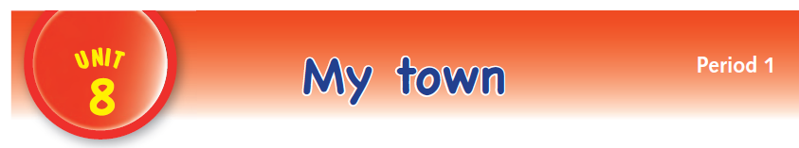

Slide 3
LANGUAGE PRESENTATION
mosque, church, shop, school, park, playground, house

Slide 4

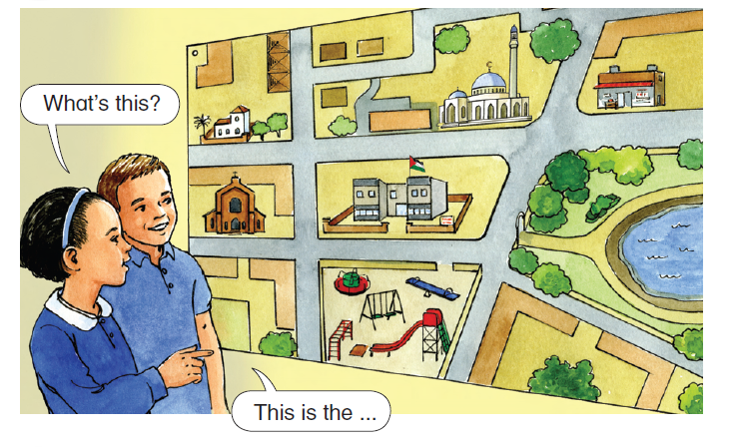
– What’s this?
– This is the mosque.
– What’s this?
– This is the park.
– What’s this?
– This is the school.
– What’s this?
– This is the playground
– What’s this?
– This is the church.
– What’s this?
– This is the shop.
– What’s this?
– This is my house!

Slide 5

– What’s this?
– This is the mosque.
– What’s this?
– This is the park.
– What’s this?
– This is the school.
– What’s this?
– This is the playground.
– What’s this?
– This is the church.
– What’s this?
– This is the shop.
– What’s this?
– This is my house!

Slide 6

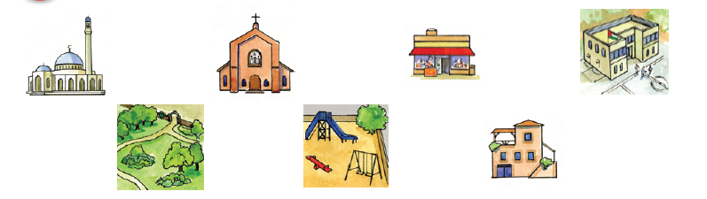

Slide 7
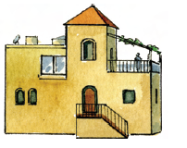
house

Slide 8
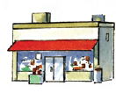
shop

Slide 9
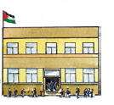
school

Slide 10
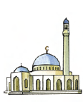
mosque

Slide 11
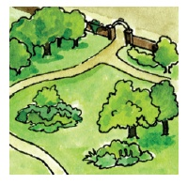
park

Slide 12
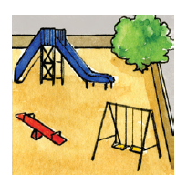
playground

Slide 13

church

