Slide 1


Slide 2
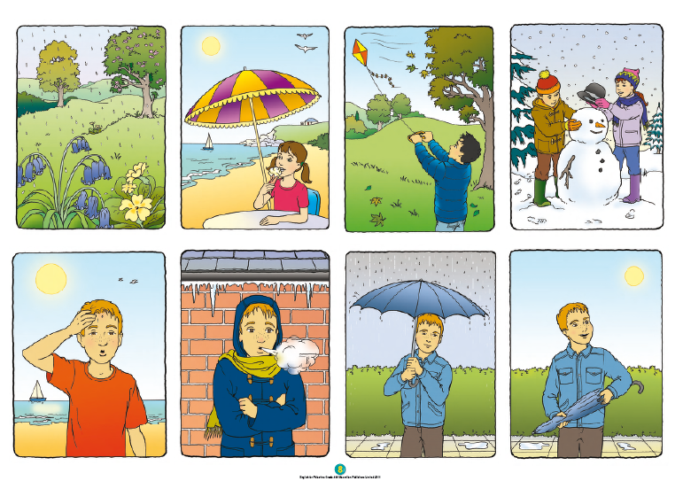

Slide 3
LANGUAGE PRESENTATION
It’s hot.
It’s cold.
It’s wet.
It’s dry.
spring, summer, autumn,
winter

Slide 4
LANGUAGE BUILDING
What / season / is / it / ?
It’s / spring / summer / autumn / winter / .

Slide 5

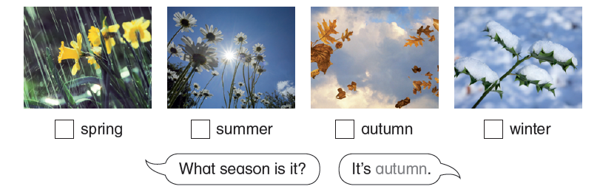
1 It’s autumn.
In autumn it’s dry and windy.
2 It’s summer.
In summer it’s hot and sunny .
3 It’s winter.
In winter it’s cold and snowy.
4 It’s spring.
In spring it’s wet and rainy.

Slide 6

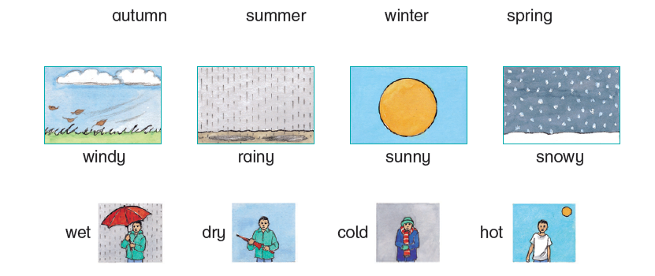

Slide 7
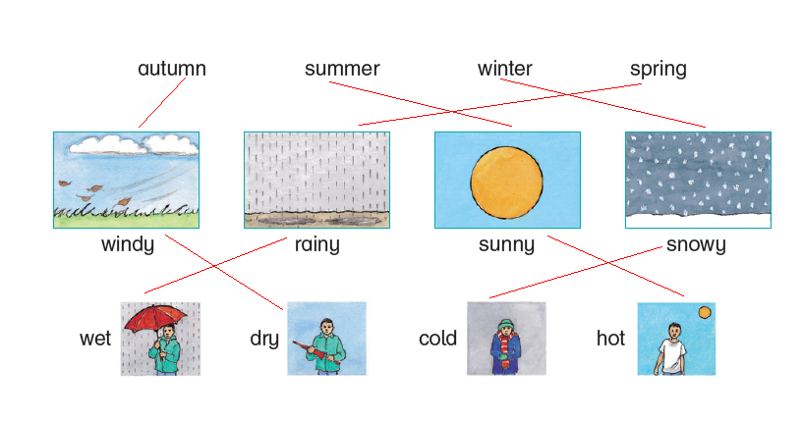

Slide 8

1 What season is it? [SFX autumn]
2 What season is it? [SFX spring]
3 What season is it? [SFX winter]
4 What season is it? [SFX summer]
Answers: 1 It’s autumn. 2 It’s spring. 3 It’s winter. 4 It’s summer.

Slide 9

1 It’s autumn.
In autumn it’s dry and windy.
2 It’s summer.
In summer it’s hot and sunny.
3 It’s winter.
In winter it’s cold and snowy.
4 It’s spring.
In spring it’s wet and rainy.

Slide 10

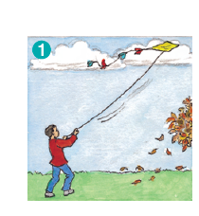

Slide 11
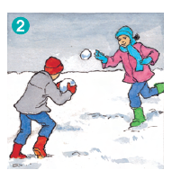

Slide 12

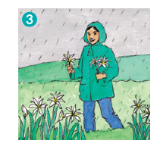

Slide 13



