Slide 1
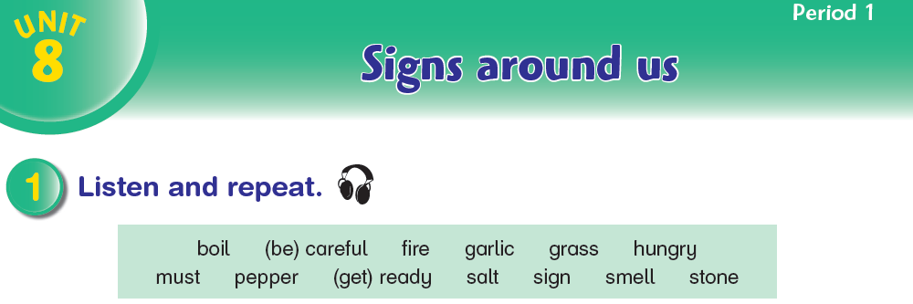

Aims to ask people to do things; to talk about obligation
and prohibition; give strong advice

Slide 2
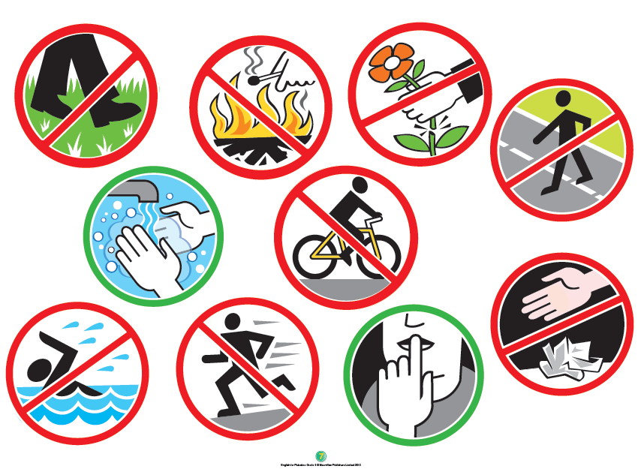

Slide 3
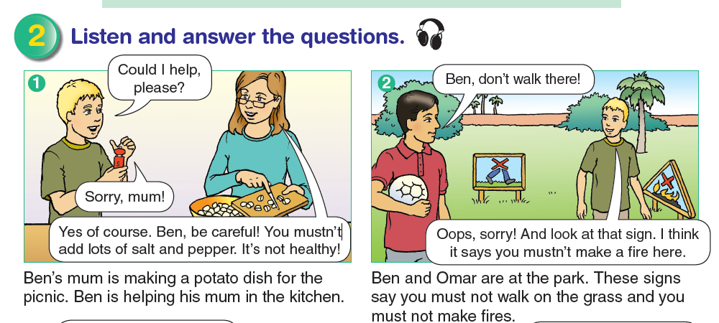

Slide 4
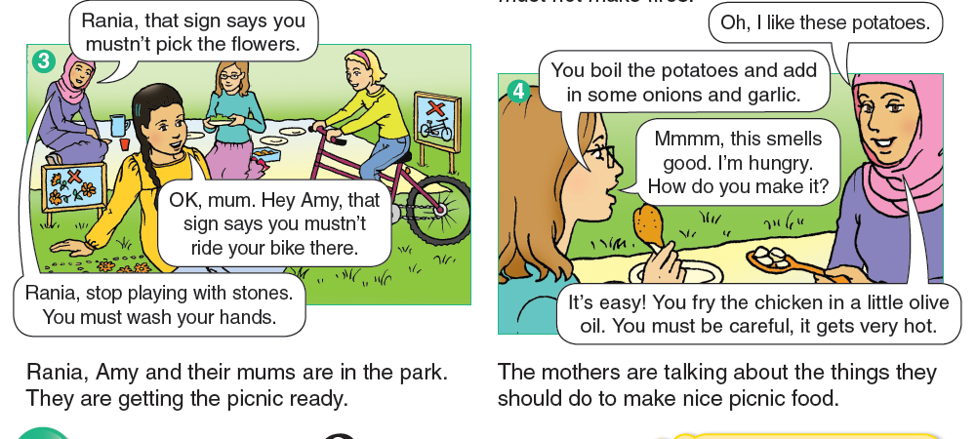

Slide 5
answer the questions.
Where are Rania and Amy’s families going? (to the park)
What are they going to do? (have a picnic)
What’s Ben doing in the kitchen? (adding salt in the potatoes)
What mustn’t you do in the park? (ride a bike, pick flowers,
walk on the grass, make fire)
What dish does Rania’s mum make? (a chicken dish)

Slide 6
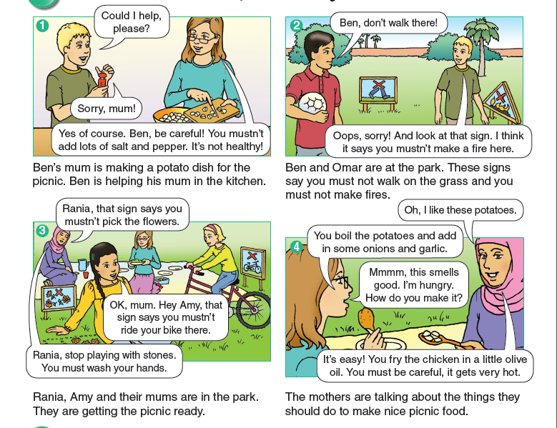
Listen and say.

Slide 7
Listen and answer the questions.
Audio 49
1 What is Ben’s mum making for the picnic?
2 Ben’s mum was not happy with him, what does she say?
3 Rania’s mum is not happy with her at the park, what does
she say?
4 What’s Amy doing at the park that she mustn’t do?
5 What’s Ben doing at the park? What mustn’t he do?
Answers: 1 a potato dish 2 You mustn’t add lots of salt and pepper.
3 You mustn’t pick the flowers. 4 ride her bike.
5 He mustn’t walk on the grass.

Slide 8
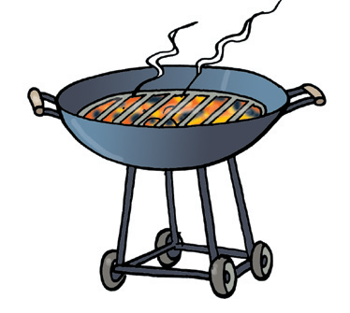
fire

Slide 9
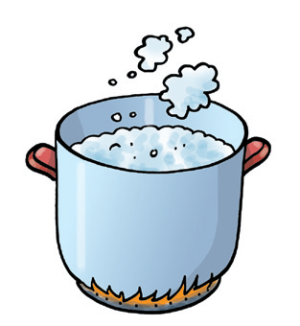
boil

Slide 10
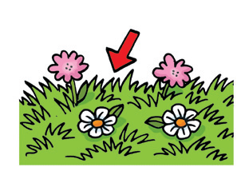
grass

Slide 11
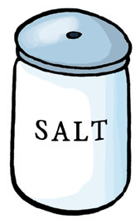
salt

Slide 12
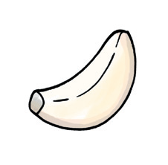
garlic

Slide 13

sign

Slide 14

stone

