Slide 1
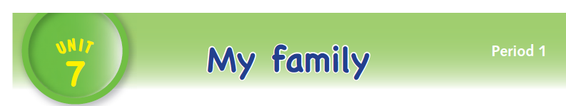

Slide 2
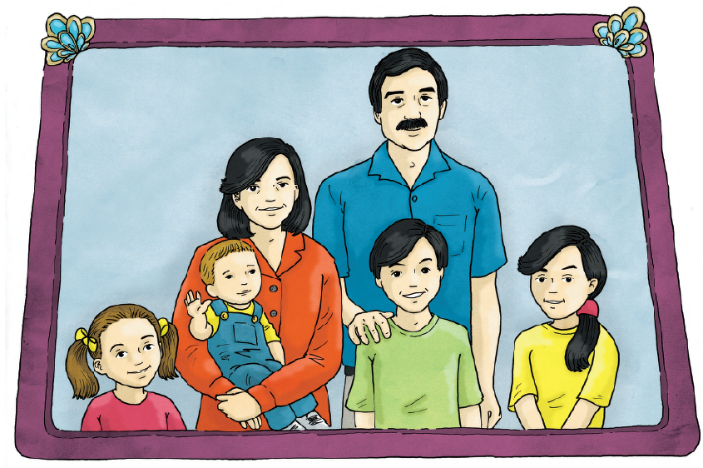

Slide 3
LANGUAGE PRESENTATION
This is my family.
Mum – Wafa, Dad – Jamal, sister – Jamila, brother – Sami,
baby – Zaid, me –Tala

Slide 4

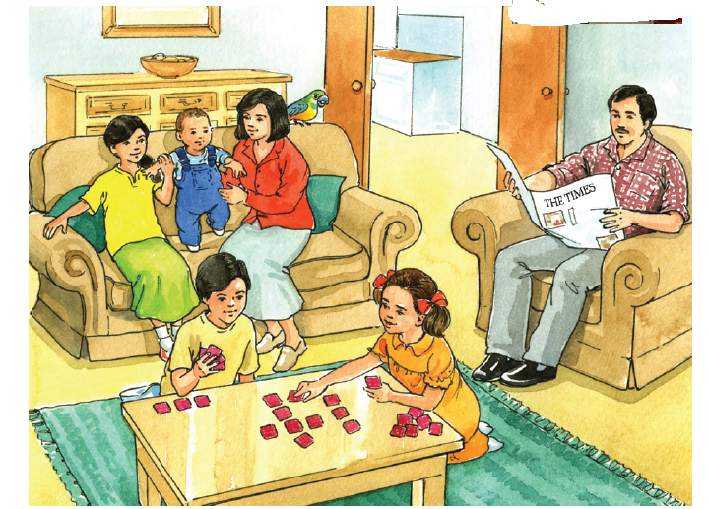
This is my family.
Mum – Wafa, Dad – Jamal, sister – Jamila, brother – Sami,
baby – Zaid, me –Tala

Slide 5


brother –Sami sister –Jamila
Mum – Wafa baby –Zaid
Dad – Jamal me –Tala

Slide 6

Baby---Zaid

Slide 7
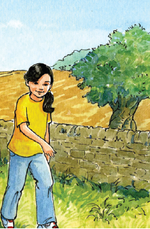
Me---Tala

Slide 8

Mum---Wafa

Slide 9

Sister---Jamila

Slide 10

Brother---Sami

Slide 11

Dad---Jamal

