Slide 1


Slide 3
LANGUAGE PRESENTATION
rug, TV, sofa, computer, telephone

Slide 4

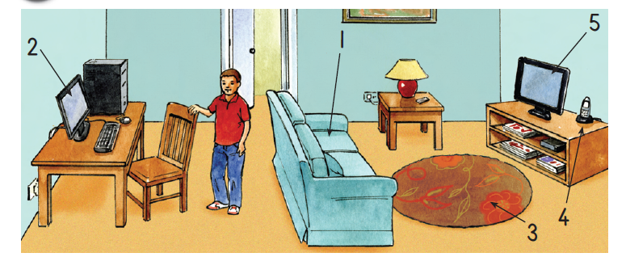
This is my living room.
This is the sofa.
This is the computer.
This is the rug.
This is the telephone.
This is the TV.

Slide 5

a TV, a rug, a telephone, a sofa, a computer

Slide 6

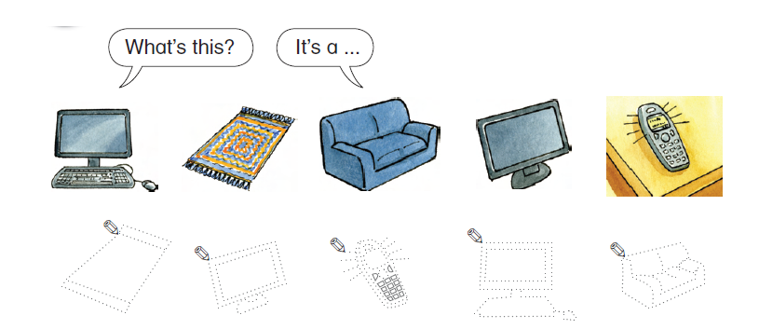

Slide 7
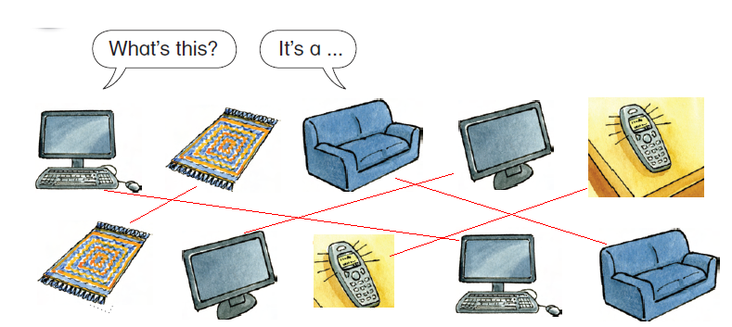

Slide 8

rug

Slide 9

sofa

Slide 10

computer

Slide 11

TV

Slide 12

telephone

Slide 13

chair

