Slide 1


Slide 2
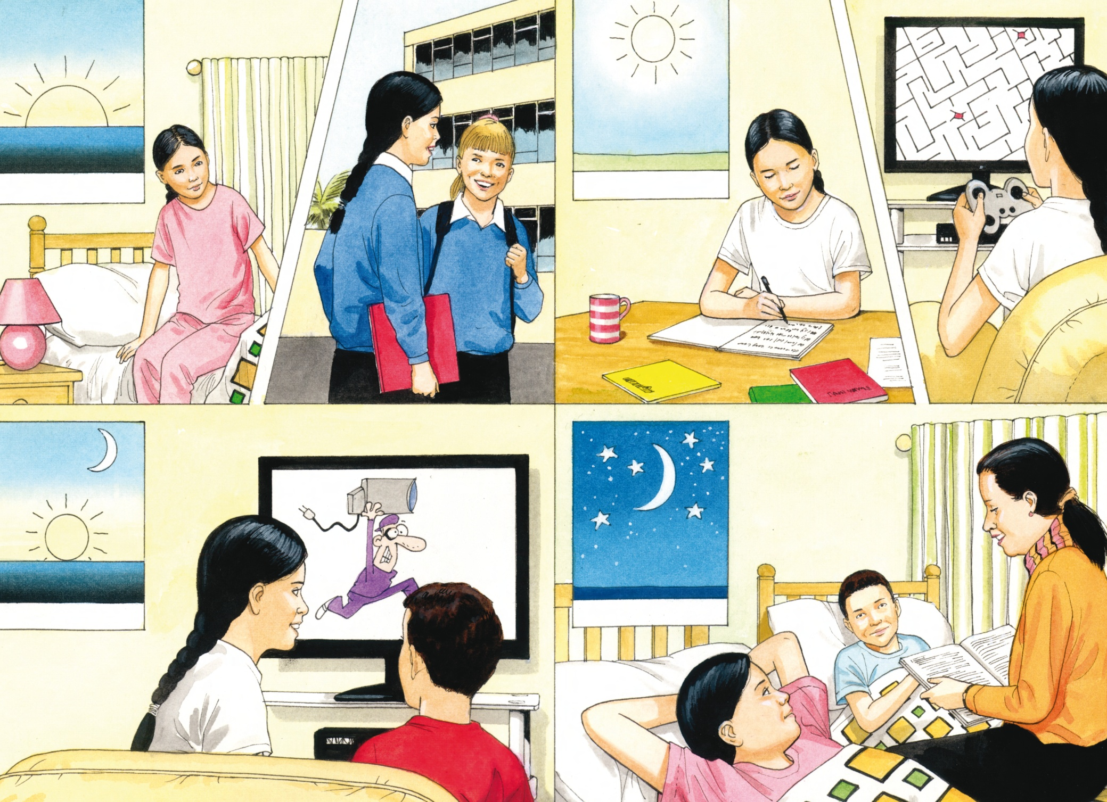

Slide 3
LANGUAGE PRESENTATION
I get up.
I go to school.
I do my homework.
I play computer games.
I watch cartoons.
I go to bed.

Slide 4
LANGUAGE BUILDING
I / go to / school / bed / watch / cartoons /
get / up / do / homework / play / computer games / .

Slide 5

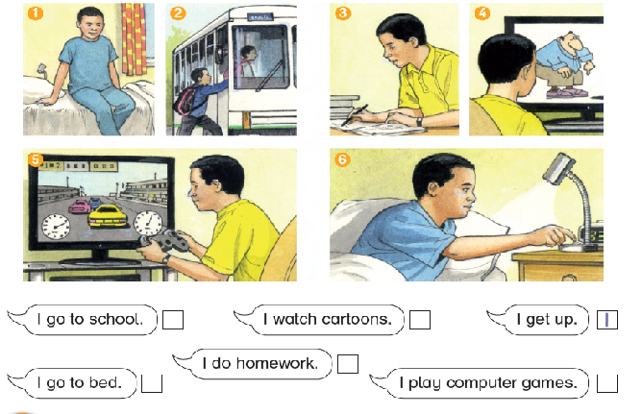
1 I get up.
2 I go to school.
3 I do homework.
4 I watch cartoons.
5 I play computer games.
6 I go to bed.

Slide 6
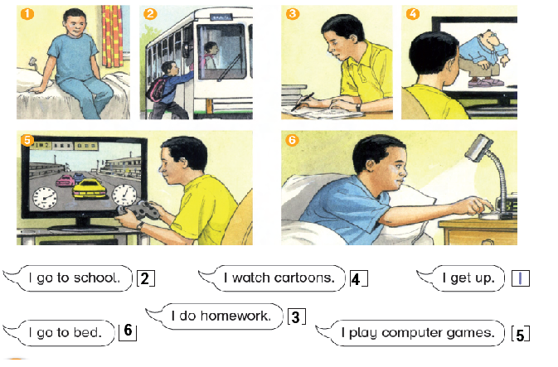

Slide 7

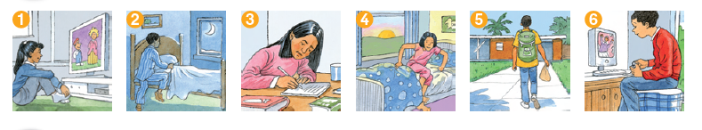
I watch …
I go …
I do …
I get …
I go …
I play …

Slide 8

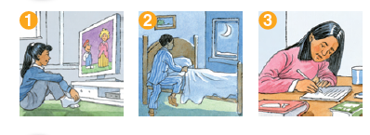
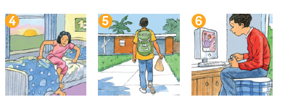

Slide 9
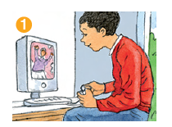
I play computer games

Slide 10
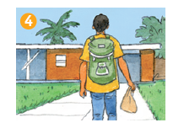
I go to school

Slide 11
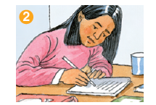
I do homework

Slide 12
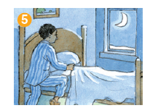
I go to bed

Slide 13
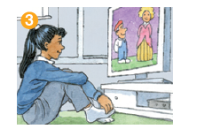
I watch cartoons

Slide 14
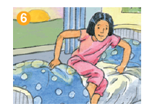
I get up

