Slide 1


Slide 2
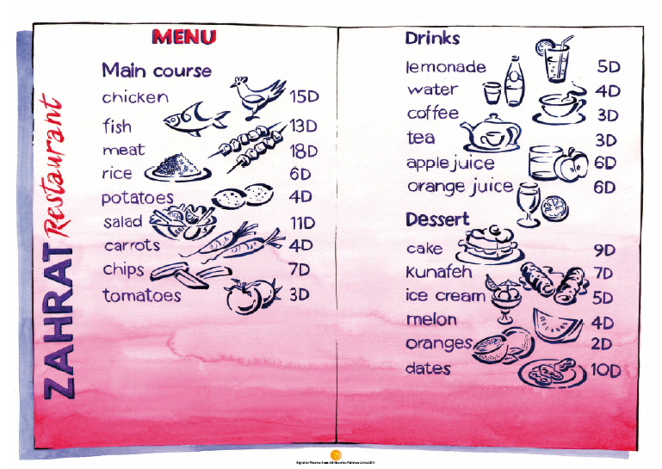

Slide 3
LANGUAGE PRESENTATION
a fork,
a knife,
a spoon,
a glass,
a napkin

Slide 4
LANGUAGE BUILDING
a / fork / knife / spoon / glass / napkin /
Could / I / have / please / ?

Slide 5

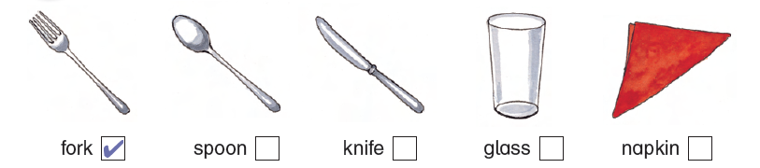
– I have a fork and a spoon.
I have a glass, too.
Where’s my napkin?
– Here it is.
– Thank you. Oh – where’s my knife? I don’t have a knife.
– Excuse me. Could I have a knife, please?
– Yes, of course.

Slide 6
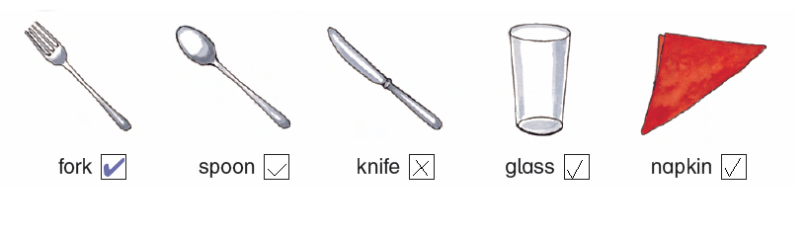

Slide 7

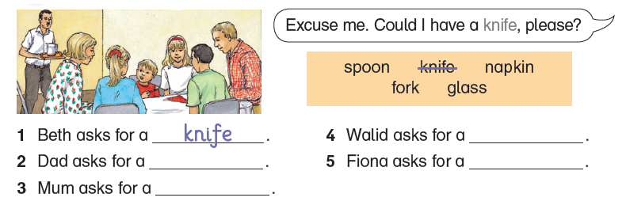
1 Excuse me. Could I have a knife, please?
2 Excuse me. Could I have a glass, please?
3 Excuse me. Could I have a fork, please?
4 Excuse me. Could I have a napkin, please?
5 Excuse me. Could I have a spoon, please?

Slide 8
napkin
glass
spoon
fork

Slide 9

1 What does mum ask for?
2 What does Walid ask for?
3 What does Fiona ask for?
4 Who doesn’t have a knife?
5 Who doesn’t have a glass?
Answers: 1 fork 2 napkin 3 spoon 4 Beth 5 dad

Slide 10

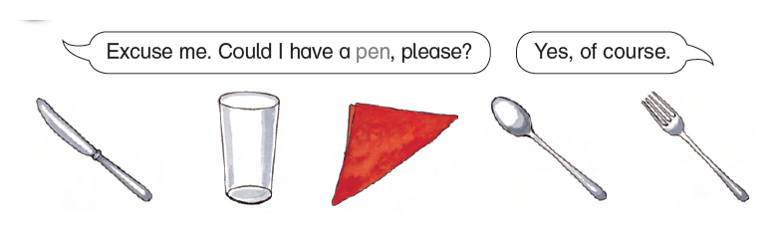

Slide 11


Slide 12



Slide 13


Slide 14



Slide 15



