Slide 1
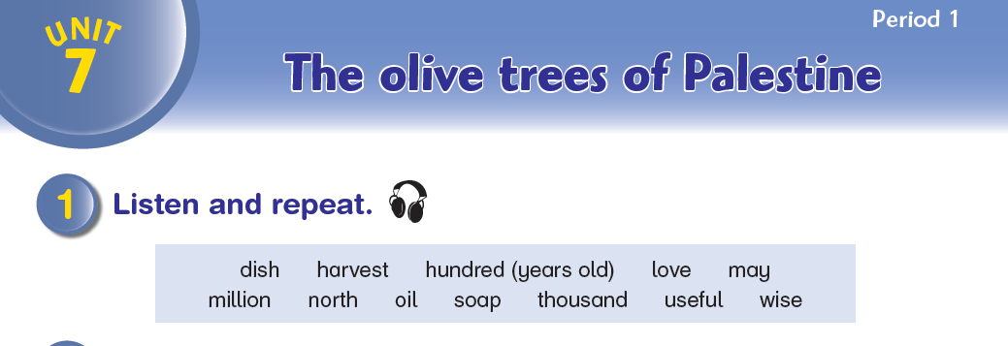

Aims to ask and give permission; make invitations; offer
and accept help

Slide 2
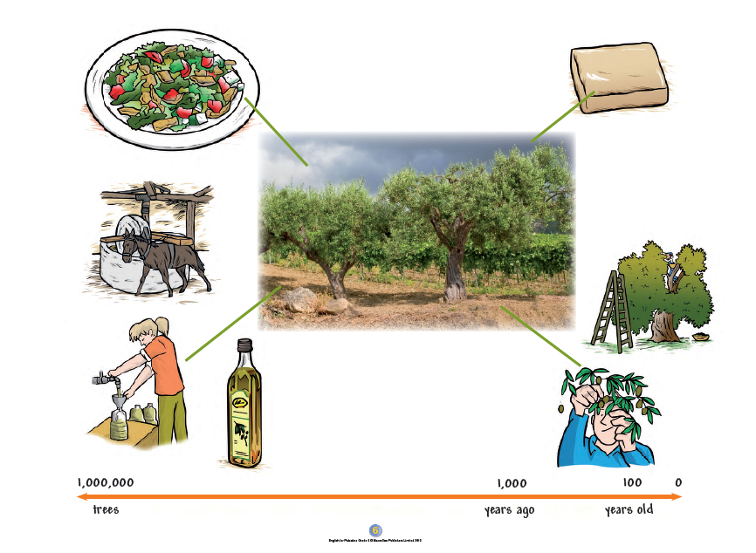

Slide 3
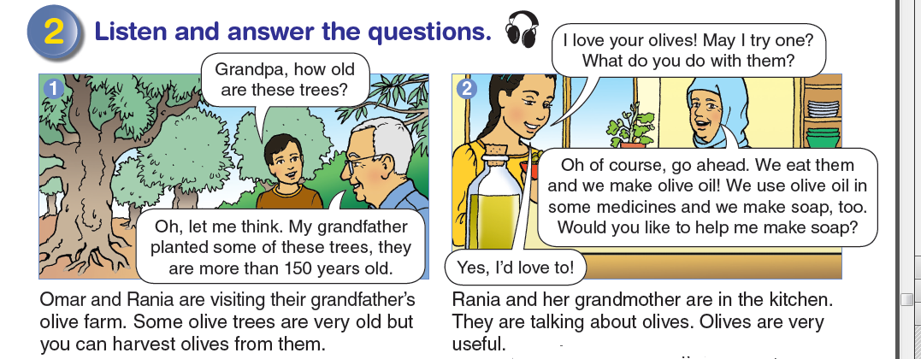

Slide 4
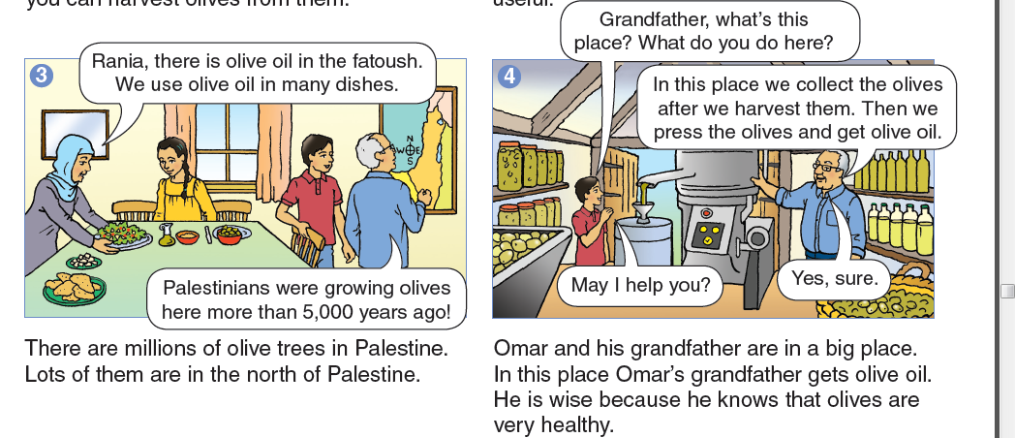

Slide 5
answer the questions.
What are 150 years old? (the olive trees)
What can you make from olives? (soap, oil, medicines, )
When did Palestinians start to grow olive trees (5,000 years ago)
How does Omar’s grandfather get the oil from the olives?
(he presses them)

Slide 6
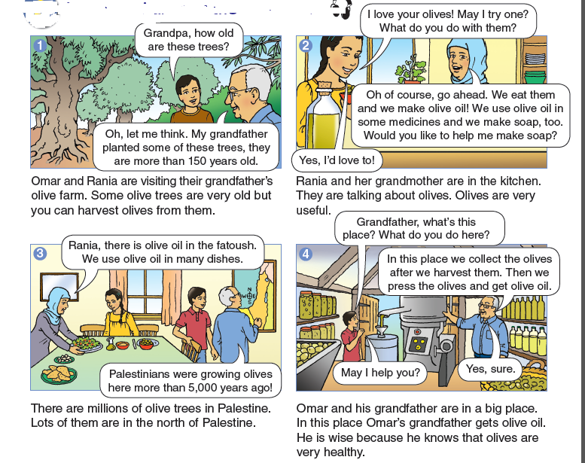
Listen and say.

Slide 7
Listen and answer the questions.
Audio 42
1 Who did Omar and Rania visit?
2 What grows on the farm?
3 Who planted some of the olive trees?
4 How many olive trees are there in Palestine?
5 What is the first thing you need to do to make olive oil?
Answers: 1 grandparents/grandmother/grandfather 2 olives
3 Omar's great grandfather/his grandfather’s grandfather
4 millions 5 harvest them/pick them/take them off the olive trees

Slide 8

love

Slide 9
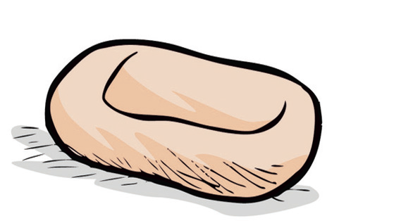
soap

Slide 10
1,000
thousand

Slide 11
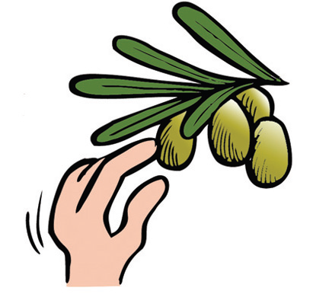
harvest

Slide 12
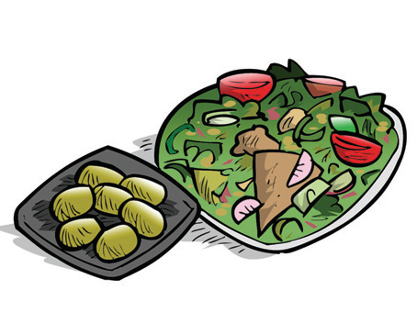
dish

Slide 13
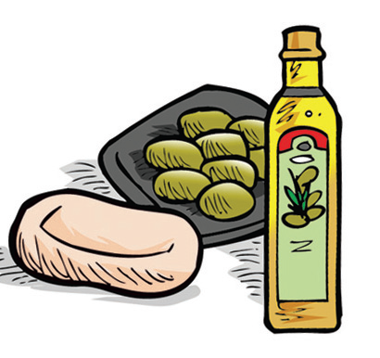
useful

Slide 14
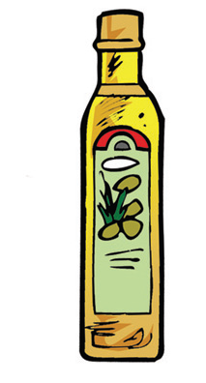
oil

