Slide 1


Slide 2
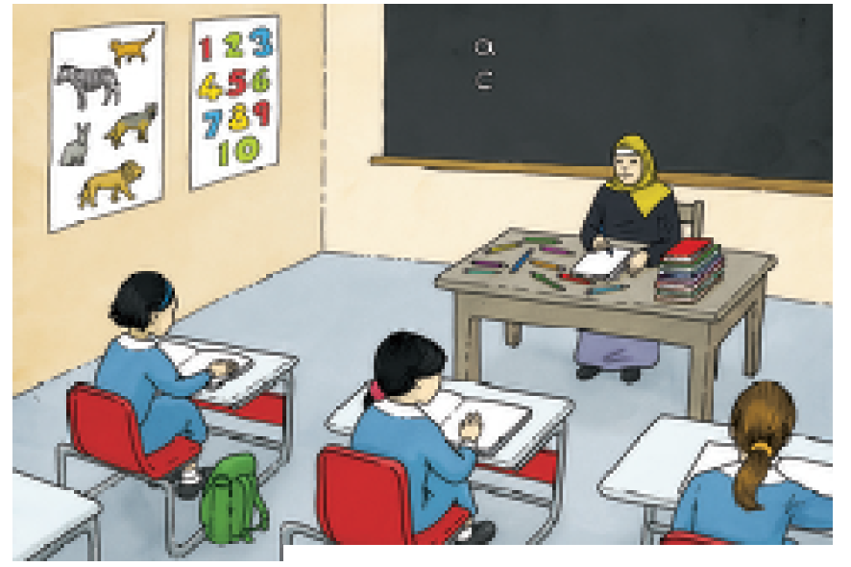

Slide 3
LANGUAGE PRESENTATION
teacher, desk, board, pencil, bag, book

Slide 4
PHONEMIC AWARENESS
The name is a. The sound is a.
The name is c. The sound is c.
The name is d. The sound is d.
The name is p. The sound is p.
The name is t. The sound is t.

Slide 5

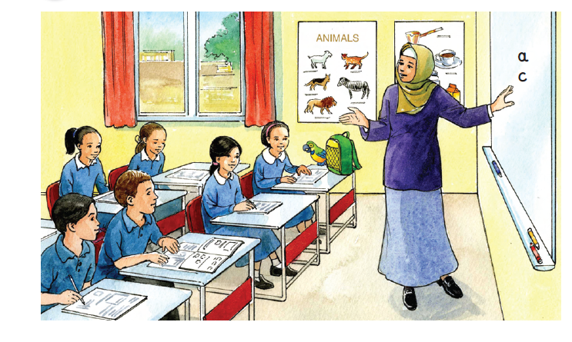
teacher, desk, board, pencil, bag, book

Slide 6

teacher, desk, board, pencil, bag, book

Slide 7

pencil, book, bag, teacher, board

Slide 8

bag

Slide 9

board

Slide 10
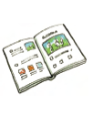
book

Slide 11

teacher

Slide 12

pencil

Slide 13
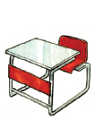
desk

