Slide 1
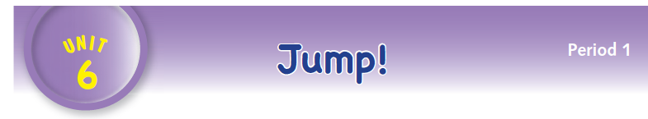

Slide 3
LANGUAGE PRESENTATION
Jump.
Hop.
Clap.
Stand up.
Sit down.
Open your hands.
Close your hands.

Slide 4

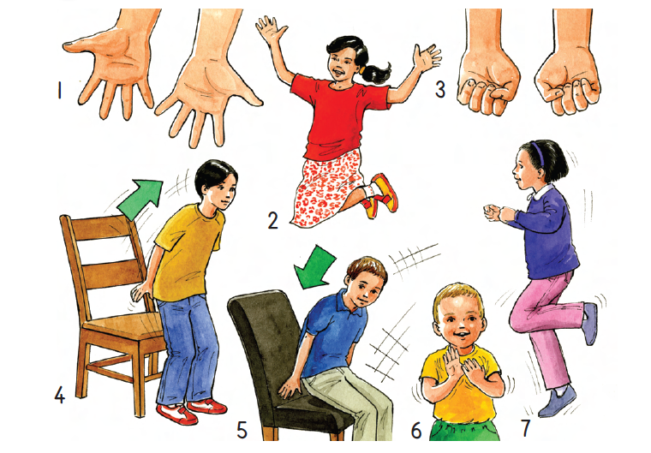
Open your hands.
Jump.
Close your hands.
Stand up.
Sit down.
Clap.
Hop.

Slide 5

Open your hands.
Jump.
Close your hands.
Stand up.
Sit down.
Clap.
Hop.

Slide 6
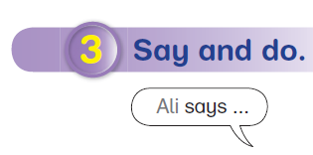
(Ali/Tala) says …

Slide 7

open your hands

Slide 8

stand up

Slide 9

jump

Slide 10

clap

Slide 11

Close your hands

Slide 12

sit down

Slide 13

hop

