Slide 1
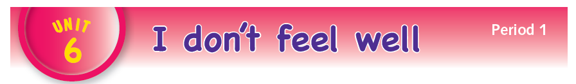

Slide 2
1
2
11
3
10
5
4
6
12
9
14
13
7
8

Slide 3
LANGUAGE PRESENTATION
My foot hurts.
My tooth hurts.
My stomach hurts.
My back hurts.

Slide 4
LANGUAGE BUILDING
My / foot / tooth / stomach / head / back / hurts / .
teeth / feet / hurt .

Slide 5

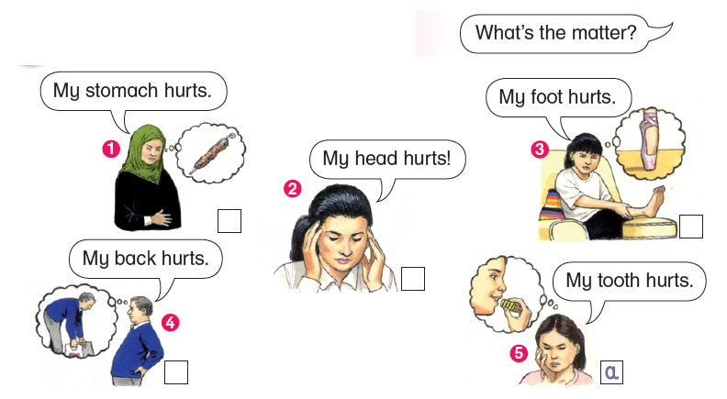
– I don’t feel very well.
– What’s the matter?
– My tooth hurts.
– Ouch, I don’t feel well.
– What’s the matter?
– My back hurts.
– Oh no, I don’t feel well.
– What’s the matter?
– My stomach hurts.
– Ow, I don’t feel well.
– What’s the matter?
– My foot hurts.
– Oh no, I don’t feel well.
– What’s the matter?
– Ow, my head hurts.

Slide 6

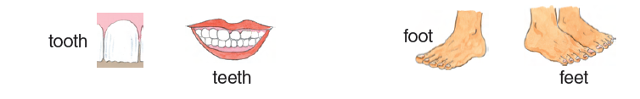
tooth … teeth
foot … feet
My tooth hurts. My teeth hurt.
My foot hurts. My feet hurt.

Slide 7

– What’s the matter?
– Ouch, my head hurts.
– Oh no, my back hurts.
– Ow, my stomach hurts.
– Ow, my teeth hurt.
– Oh no, my feet hurt.

Slide 8

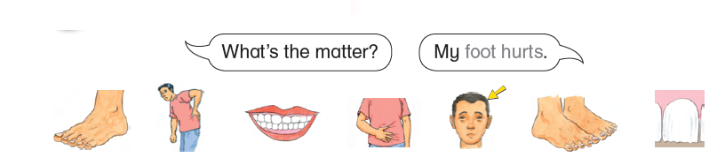

Slide 9

foot

Slide 10

back

Slide 11

teeth

Slide 12

stomach

Slide 13

head

