Slide 1


Slide 2
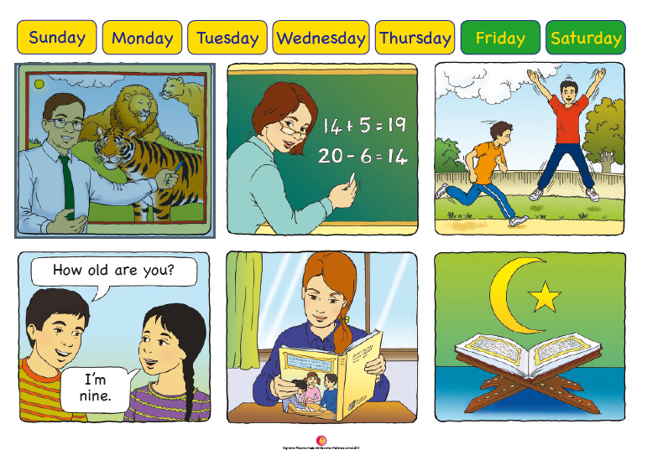

Slide 3
LANGUAGE PRESENTATION
maths, PE, Arabic, science, religion, English
What subjects do we have today?
We have English and maths.

Slide 4
LANGUAGE BUILDING
English / Arabic / PE / religion / science / maths
What / subjects / do / we / have / today / ? / We / have / .

Slide 5

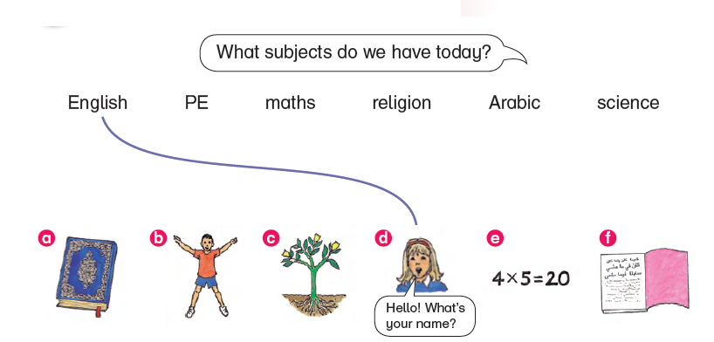

Slide 6
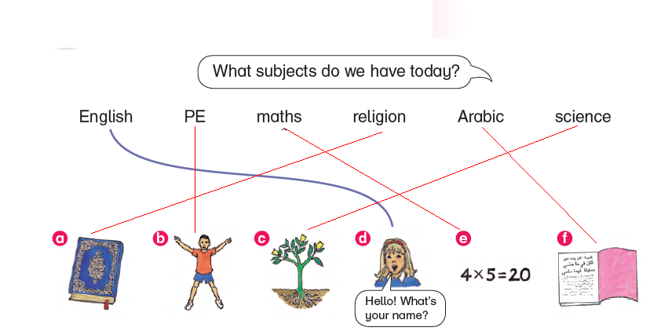

Slide 7

1 You speak and sing songs in …
2 You learn about numbers in …
3 You run and jump in …
4 You read stories in …
5 You learn about animals, flowers and trees in …
6 You read the Qu’ran in …
Answers: 1 English 2 maths 3 PE 4 Arabic
5 science 6 religion

Slide 8

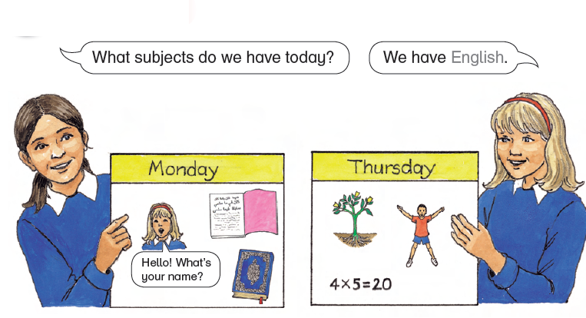

Slide 9


Slide 10



Slide 11



Slide 12



Slide 13



Slide 14



