Slide 1
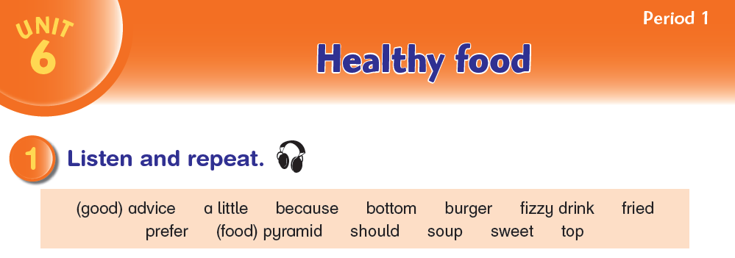

Aims to give advice; to use the conjunction because

Slide 2
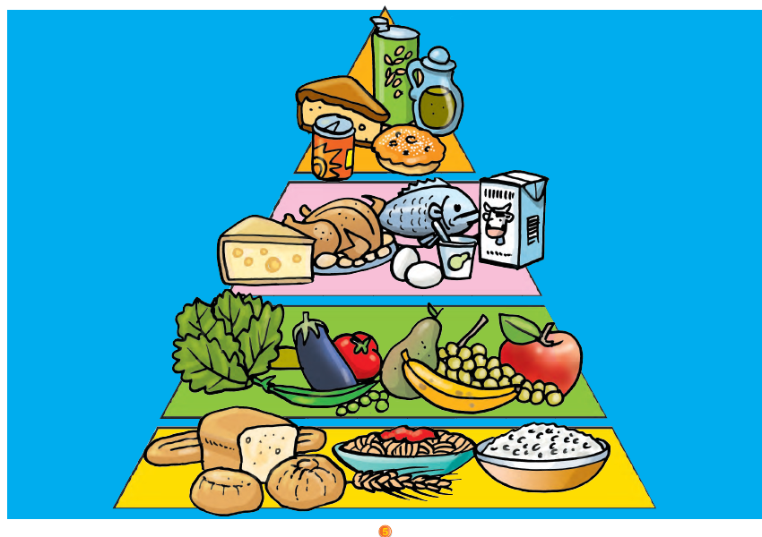

Slide 3
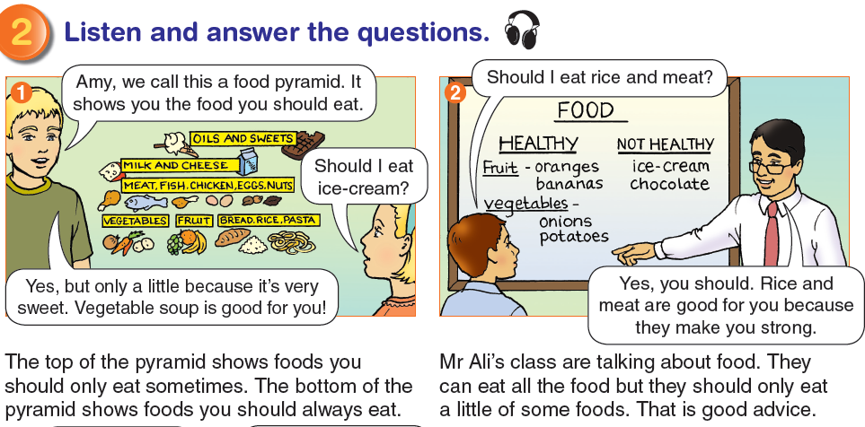

Slide 4
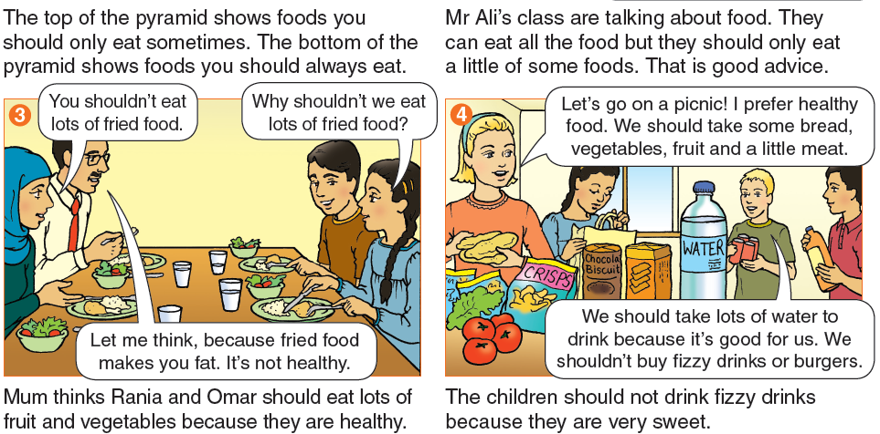

Slide 5
answer the questions.
What food should you eat lots of? (vegetables, fruit]
What food should you eat a little of? (fried food)
What should you drink lots of? (water)
What should you drink a little of? (fizzy drinks)
Why should you not eat lots of fried food? (because they
make you fat, they are not healthy)

Slide 6
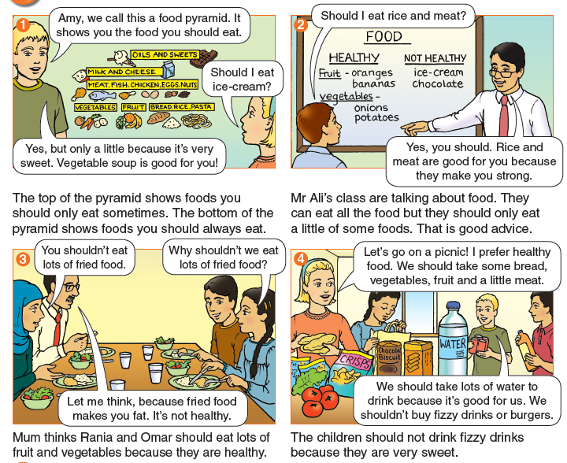
Listen and say.

Slide 7
Listen and answer the questions.
Audio 35
1 What does a food pyramid show?
2 Why should you only eat a little ice-cream?
3 Why should you eat lots of vegetables?
4 Why shouldn’t you eat lots of fried food?
5 Why shouldn’t you drink lots of fizzy drinks?
Answers: 1 Healthy and not healthy food 2 It’s very sweet 3 they
are healthy 4 they make you fat, they are not healthy 5 they are
very sweet

Slide 8
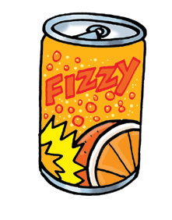
fizzy drink

Slide 9
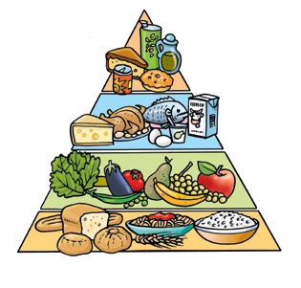
food pyramid

Slide 10
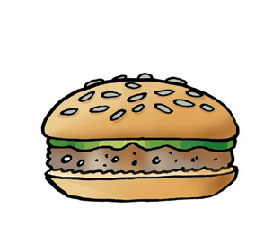
burger

Slide 11

sweet

Slide 12
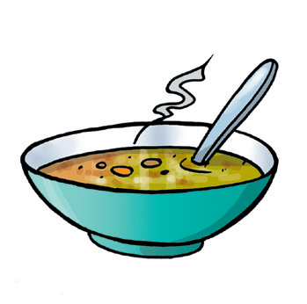
soup

Slide 13
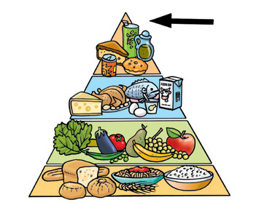
top

Slide 14
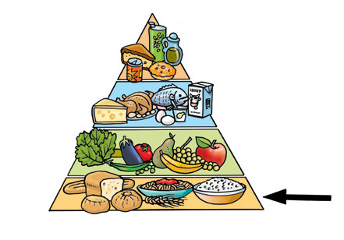
bottom

